Slide 1
Recurrence Relation & Generating Function
Discrete Math

Slide 2
What is Discrete Mathematics ?
Discrete mathematics is the study of mathematical structures that are countable or otherwise distinct and separable.
Examples of structures that are discrete are combinations, graphs, and logical statements. Discrete structures can be finite or infinite.
Discrete mathematics is in contrast to continuous mathematics, which deals with structures which can range in value over the real numbers, or have some non-separable quality.

Slide 3
Everyday Applications of Discrete Mathematics
Computers
The software and files are both stored as huge strings of 1s and 0s. Binary math is discrete mathematics.
Google Maps
It uses discrete mathematics to determine fastest driving routes and times.
Cryptography
Encryption and decryption are part of cryptography, which is part of discrete mathematics. For example, secure internet shopping uses public-key cryptography.
Digital image processing
It uses discrete mathematics to merge images or apply filters.

Slide 4

Tower of Hanoi
The objective of the puzzle is to move entire stack to another rod obeying the following rules :
Only one disk may move at a time.
Each move consists of taking upper disk from one of the rods & sliding it onto another rod, on top of the other disks that may already be present on that rod.
No disk may be placed on top of a smaller disk.

Slide 5

Tower of Hanoi
Step 1 − Move n-1 disks from source to aux
Step 2 − Move n^{th} disk from source to dest
Step 3 − Move n-1 disks from aux to dest
-------------------------------------------------------------
|Total Number of moves needed to solve for | | given ‘N’ disks : 2^{n} − 1 |
| |
------------------------------------------------------------
Source Auxiliary Destination

Slide 6
Recurrence relations
A recurrence relation is an equation that recursively defines a sequence where the next term is a function of the previous terms (Expressing Fn as some combination of Fi with i<n).
Example − Fibonacci series − Fn=Fn−1+Fn−2Fn, Tower of Hanoi − Fn=2Fn−1

Slide 7
Types of recurrence relations
First order Recurrence relation :- A recurrence relation of the form : a_{n} = ca_{n-1} + f(n) for n>=1 where c is a constant and f(n) is a known function is called linear recurrence relation of first order with constant coefficient. If f(n) = 0, the relation is homogeneous otherwise non-homogeneous.
Example :- x_{n} = 2x_{n-1} – 1, a_{n} = na_{n-1} + 1, etc.

Slide 8
Backtracking Method
Example:- an=an-1 +3 , a1=2
Then an-1 = an-2 +3
an-2 = an-3 +3
an-3 = an-4 +3 and so on.
Therefore,
an=an-1 +3
=(an-2 +3 )+3 =an-2 +2*3
=(an-3 +3)+6 =an-3 +3*3 . . . .
=a1+(n-1)*3.
So,
an =2+(n-1)*3

Slide 9
Second order liner homogenous recurrence relation
Definition:
A recurrence relation of the form Ba_{n} + Ca_{n-1} + Da_{n-2} = 0 ——> (1)
is called a second order linear homogeneous recurrence relation with constant coefficients. Solution to this is in form a_{n} = ck^{n} where c, k!=0 Putting this in (1) Br^{n} + Cr^{n-1} + Dr^{n-2} = 0 r² + r + 1 = 0 —–> (2)
Thus, a_{n} = r^{n} is solution of (1) if k satisfies quadratic equation (2). This equation is called characteristic equation for relation (1).

Slide 10
Various Cases
Real and Distinct roots
3 cases
Complex roots
Repeated Real Roots

Slide 11
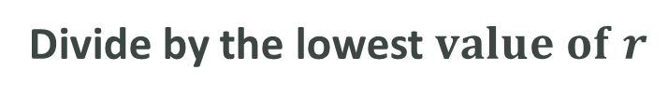

Procedure to solve:
Given equation
Change the given equation $a_{n}$ into $r^{n}$
Divide by the lowest $value of r$
Quadric equation
Find the two roots r1 , r2
Solve

Slide 12
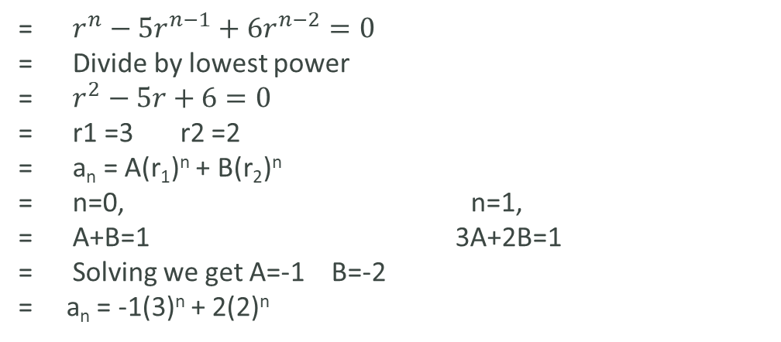
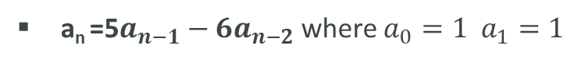
Case 1: Roots are Real & Distinct
If the two roots k₁, k₂ of equation are real and distinct then, we take a_{n} = A(k₁)^{n} + B(k₂)^{n}
as general solution of (1) where A and B are arbitrary real constants.
Problem :
a_{n} =5$a_{n−1}−6a_{n−2}$ where $a_{0}=1 a_{1}=1$
= $r^{n}−{5r}^{n−1}+{6r}^{n−2}=0$
= Divide by lowest power
= $r^{2}−5r+6=0$
= r1 =3 r2 =2
= a_{n} = A(r₁)^{n} + B(r₂)^{n}
= n=0, n=1,
= A+B=1 3A+2B=1
= Solving we get A=-1 B=-2
= a_{n} = -1(3)^{n} + 2(2)^{n}

Slide 13
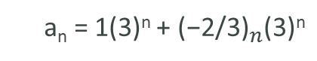
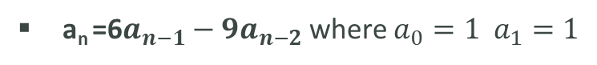
Case 2: Roots are Real & Equal
If the two roots k₁, k₂ of equation are real and equal, with k as common value then, we take a_{n} = (A + Bn)k^{n}
as general solution of (1) where A and B are arbitrary real constants.
Problem:
a_{n} =6$a_{n−1}−9a_{n−2}$ where $a_{0}=1 a_{1}=1$
a_{n} = 1(3)^{n} + ${\text{(−2/}\text{3}\text{)}}_{n}$(3)^{n}
Ans =

Slide 14
Case 3: Roots are Complex
If the two roots k₁ and k₂ of equation are complex then, k₁ and k₂ are complex conjugate of each other i.e k₁ = p + iq and k₂ = p – iq and we take
a_{n} = r^{n}(Acosnθ + Bsinnθ)
as general solution of (1) where A and B are arbitrary complex constants, r = |k₁| = |k₂| = √p² + q² and θ = tan⁻¹(q/p).

Slide 15
THANK YOU
Venkatesh D
K Rahul
Vaishnavi R
Akriti J

Slide 16

Add a Slide Title - 2
ANY
QUESTIONS????

